Slide 1
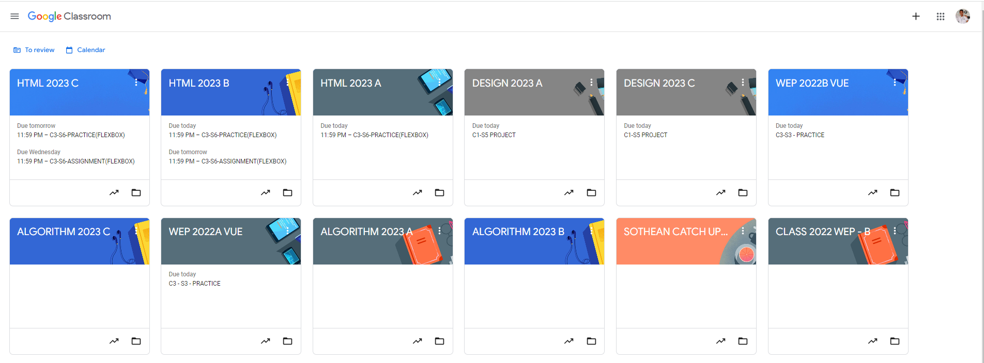
Root div
- Height: 100vh
content
nav
Flex: 0
header
Flex: 0
Flex: 1

Slide 2
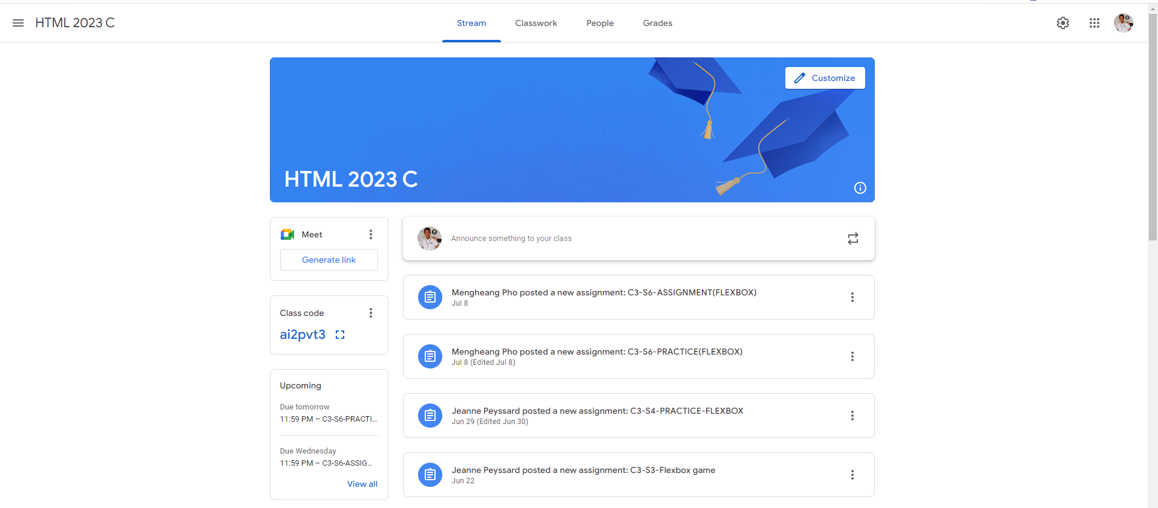
Identify root components of website below

Slide 3
Flex : 0
Header
Flex : 1
Main

Slide 4
Header-left
Navigation
Header-right
Main-Title
Main-Content

Slide 5
SideBar
Primary-content

